Slide 1
So What the Heck Is This Radio Thing, Anyway?
Notes:
Talk is to introduce SDR users to the fundamentals of radio, the magic cloud on the other side of their antenna port.

Slide 2
Who am I?
Computer geek, ham radio operator, electronics fiddler, RC pilot, cat and dog servant, etc…
Notes:
Ham radio operator for 17 years (we’ll talk more about ham radio later), playing with electronics and computers since first grade, sysadmin, network engineer, security engineer, etc
On to the content!

Slide 3
A Brief History of Radio
Spark-gap transmitter (late 1800s to early 1900s)
Crystal radio receiver (early 1900s through around 1930)
Vacuum tubes (early 1900s)
Transistor radios (mid-1950s onward)
Software-defined radios (mid-1980s, more widespread mid-90s)
Notes:
Spark-gap: Literally a spark jumping a gap, like a bolt of lightning. Made a very wide-band noisy signal (like static, just stronger than background levels)
Crystal radio: Tuned circuit with an inductor (coil) and a capacitor (either discrete or using the antenna’s capacitance), and a diode (the crystal) to rectify the signal into audio. Powered by the signal received!
Vacuum tubes: Provided rectification (diode tubes) and amplification (triode tubes) of signals
Transistors: Solid-state devices performing the amplification duties of triodes, and also solid-state diode devices for rectification
SDR: Take as much hardware out of the RF processing as possible, digitize and process as much in software.

Slide 4
What is SDR?

Slide 5
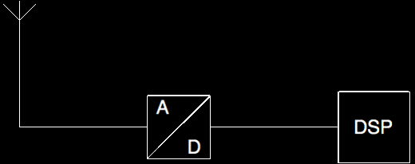
What is SDR?
Notes:
Very basic: Take RF from an antenna, feed into an analog-to-digital converter, and then process in software.

Slide 6
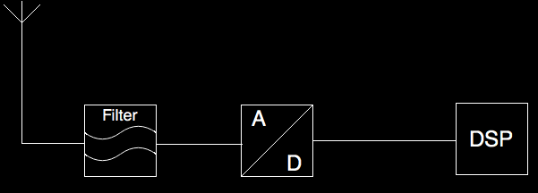
What is SDR?
Notes:
We add a filter to reject unwanted signals that can cause aliasing (more on aliasing, sampling, and Nyquist later)

Slide 7
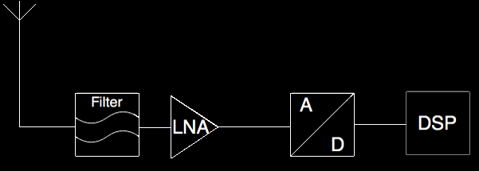
What is SDR?
Notes:
We add an amplification stage to increase the strength of signals received.

Slide 8
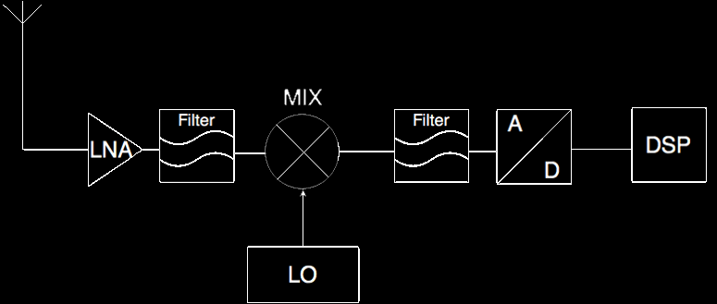
What is SDR?
Notes:
We add a mixer, a local oscillator, and another filter (and apparently screw up where our preselector filter and LNA are arranged)
Neat property of RF signals, when combined you have A, B, A+B, A-B. (sum and difference)
So 100MHz and 110MHz you get 100, 110, 210, 10.

Slide 9
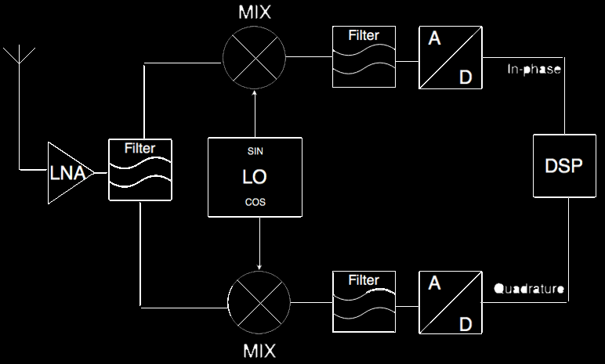
What is SDR?
Notes:
An alternative to having a single ADC sampling at twice our desired signal frequency, is two ADCs at half that sample rate, one sampling an in-phase signal, and one sampling a 90-degree-out-of-phase signal. Mathematically identical, it’s harder to find ADCs that sample at 2x your bandwidth if you want to capture a lot.

Slide 10
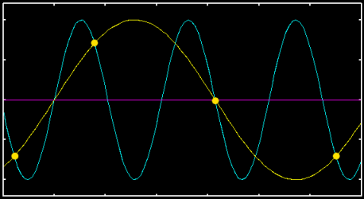
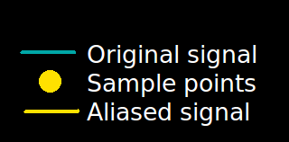
You mentioned this Nyquist guy…
Sample at a rate at least twice the frequency of the signal, otherwise…
Notes:
Aliasing is the presentation of a false signal due to undersampling

Slide 11
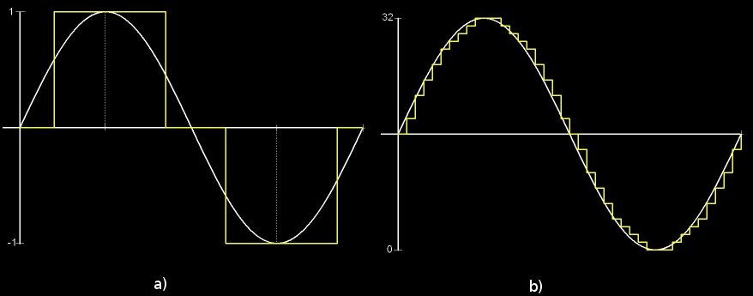
Is sample rate the only important thing?
Bit depth is important to amplitude-modulated signals & dynamic range
Notes:
Dynamic range gives you the ability to see both strong and weak signals at the same time

Slide 12
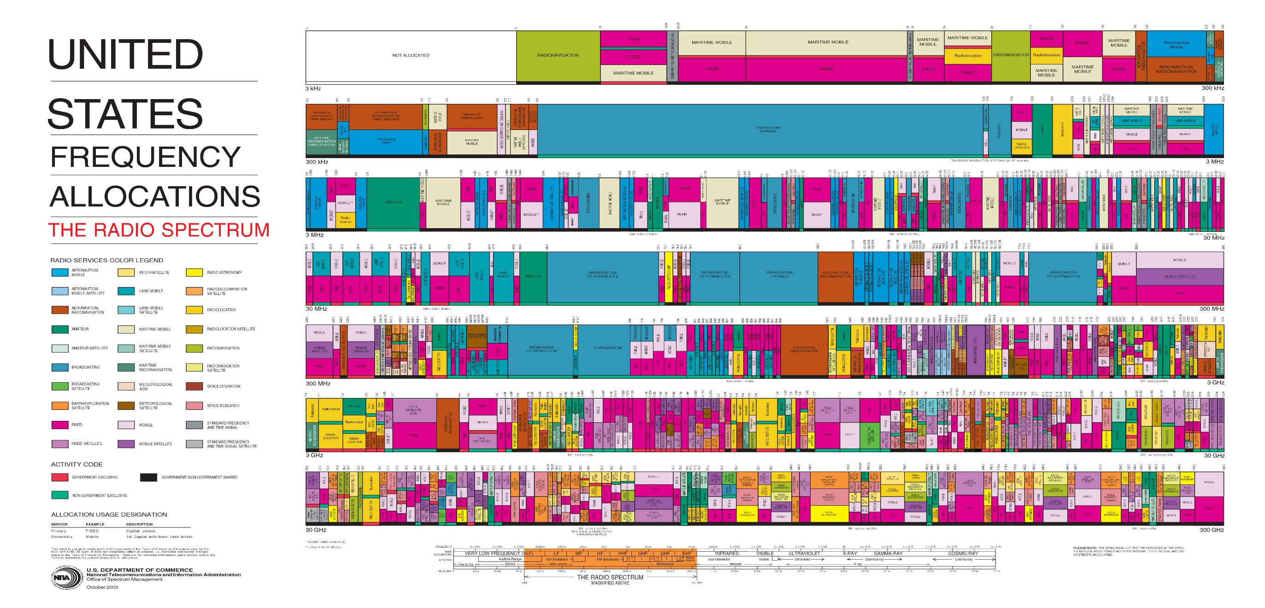
Okay, so what are we actually receiving?
Notes:
Electromagnetic spectrum! This is the radio portion. 3kHz to 300GHz displayed. Hz is cycles per second (or frequency). Sometimes radio is referred to by wavelength (2 meters for example), which is the inverse of the frequency (1/f) and expressed by lambda.
Also electromagnetic spectra: light (visible, IR, UV), X-Rays, gamma rays

Slide 13
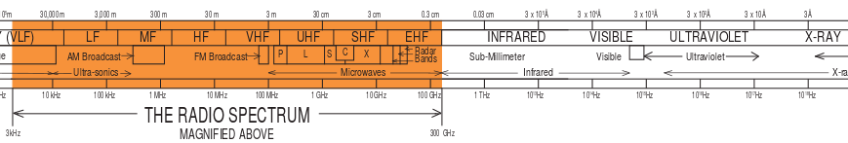
Okay, so what are we actually receiving?
Notes:
Electromagnetic spectrum! This is the radio portion. 3kHz to 300GHz displayed. Hz is cycles per second (or frequency). Sometimes radio is referred to by wavelength (2 meters for example), which is the inverse of the frequency (1/f) and expressed by lambda.
Also electromagnetic spectra: light (visible, IR, UV), X-Rays, gamma rays

Slide 14
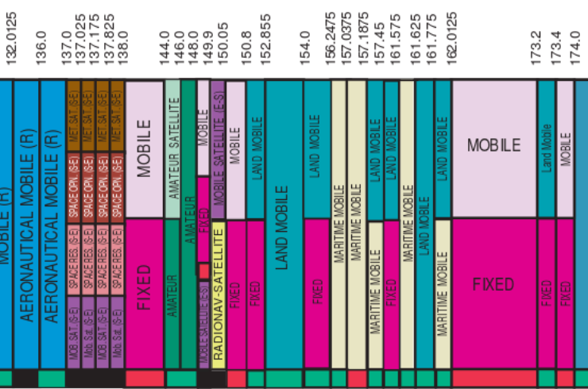
Okay, so what are we actually receiving?
Notes:
Electromagnetic spectrum! This is the radio portion. 3kHz to 300GHz displayed. Hz is cycles per second (or frequency). Sometimes radio is referred to by wavelength (2 meters for example), which is the inverse of the frequency (1/f) and expressed by lambda.
Also electromagnetic spectra: light (visible, IR, UV), X-Rays, gamma rays

Slide 15
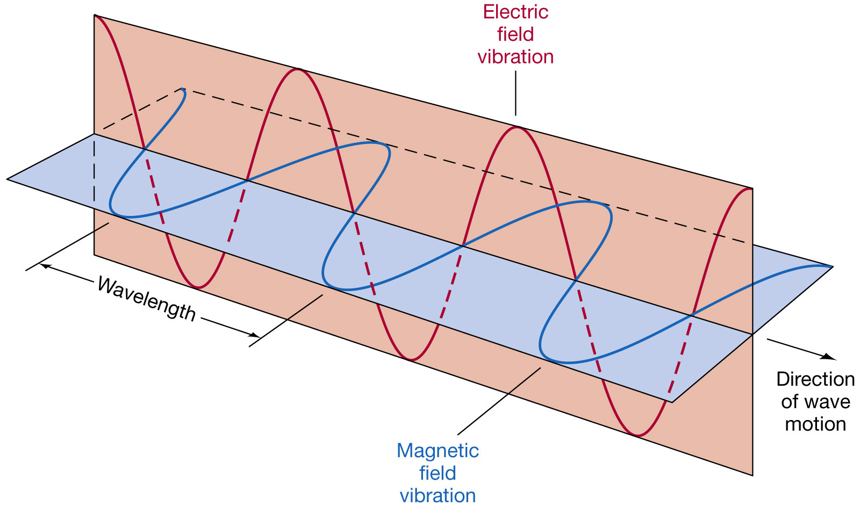
But what is an electromagnetic wave?
Transverse wave with electric field and magnetic field components
Notes:
A charge is wiggled (oscillated at a frequency) on a conductive tuned thingie (aka antenna), where it produces an electric field oscillation along the length of the antenna, and a magnetic field oscillation perpendicular to the antenna.

Slide 16
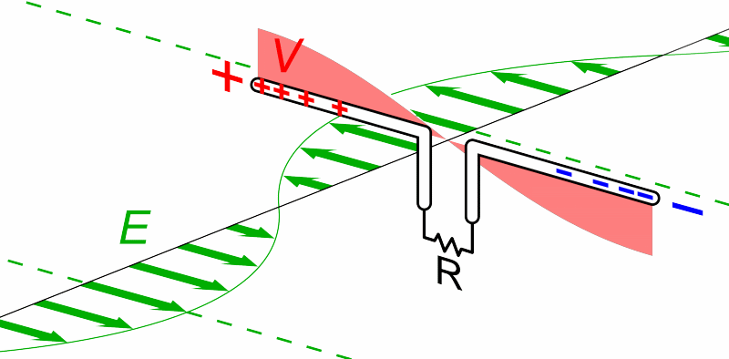
How do we receive the wave?
With an antenna!

Slide 17
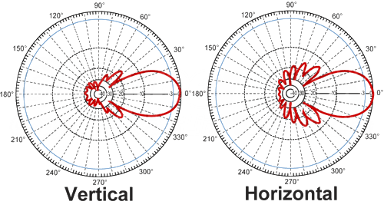
Tell me more about antennas…
Tuned to radiate for frequency and bandwidth
Gain expressed in dBi (tTX power expressed in dBm)
Polar radiation charts
Notes:
Frequency we talked about, bandwidth in radio terms is literally the width of the band…so frequency of 200MHz, bandwidth of 10MHz, would be ideal for 195MHz-205MHz.
An ideal isotropic radiator radiates in all directions…and doesn’t exist. 0dBi decibels isotropic. Decibel is a logarithmic scale, meaning every increase of 10dB is 10x…so 10dB is 10x gain, 20dB is 100x gain, so on. 3dB is double.
More gain means more signal strength, but gets more focused/directional.
Polar radiation charts show gain characteristics in the E (electric field, vertical) plane and H (magnetic field, horizontal) plane.

Slide 18
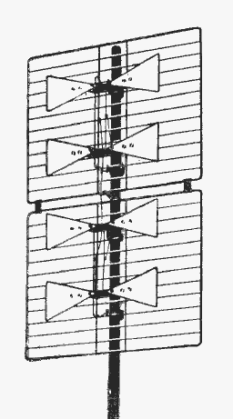
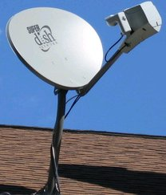
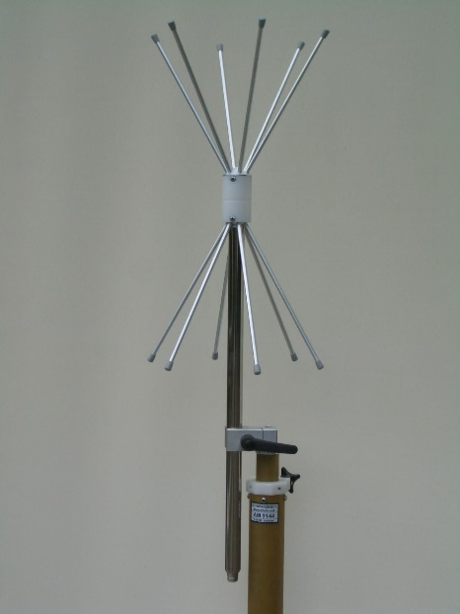
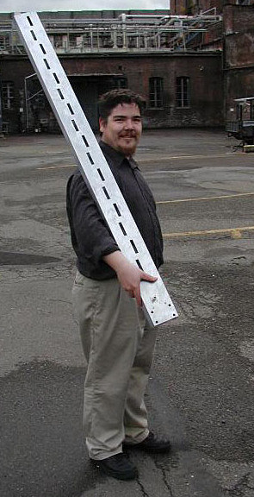
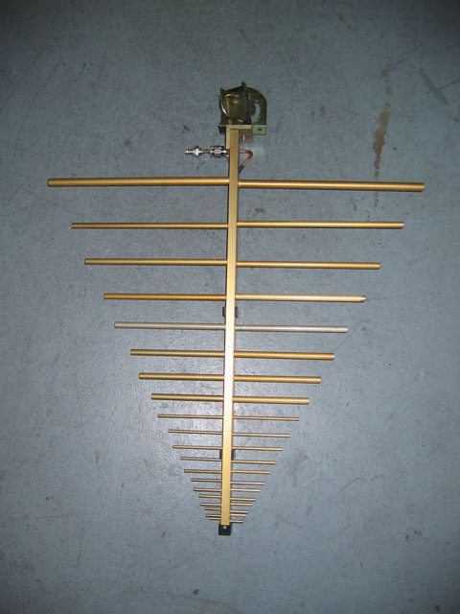
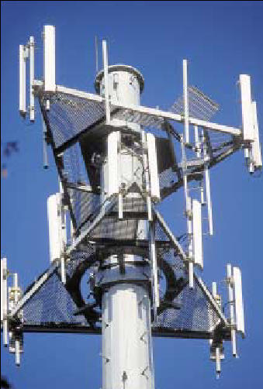
MOAR ANTENNAS
Many different types…

Slide 19
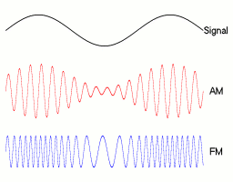
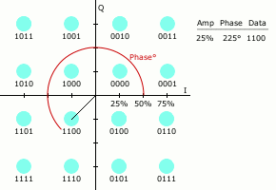
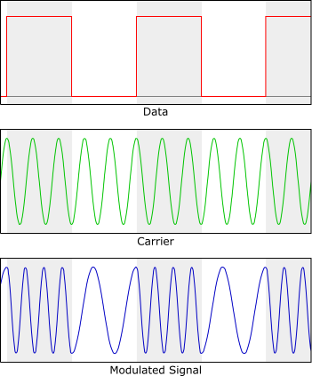
So how do we use all this to communicate?
Modulation!
Analog
AM
FM
Digital
OOK
FSK
PSK
QAM
OFDM
Notes:
Modulation is the encoding of data within a carrier signal.
Charts: Top left is amplitude modulation vs frequency modulation, bottom left is binary frequency shift keying
Right is Quadrature Amplitude Modulation (QAM16 specifically)

Slide 20

Just how much data can we send?
Ask information theorists!
Channel capacity
Shannon-Hartley theorem
Example:
20MHz bandwidth
-70dB signal
-90dB noise
86mbit/sec
Better SNR? -60dB signal, -110dB noise, 112mbit/sec
Double bandwidth? -60dB signal, -110dB noise, 40MHz BW, 225mbit/sec
Notes:
Channel capacity in bits/sec, Bandwidth in Hz, Signal and Noise in dB. Calculation is assuming I haven’t screwed up my math, which is entirely likely…
SNR changes throughput logarithmically, bandwidth changes throughput linearly.
MIMO increases channel capacity, not linearly with number of streams though (don’t know what the correlation is)

Slide 21
Where do I go to learn more?
For RF:
Amateur Radio license! Today (Tuesday) at 7pm
http://conham.org/exams.html
http://www.kb6nu.com/study-guides/
http://www.arrl.org/ham-radio-license-manual
ARRL Handbook, http://www.arrl.org/arrl-handbook-2015
RF for non-RF engineers, http://www.ti.com/lit/ml/slap127/slap127.pdf
NXP RF Basics, https://www.youtube.com/watch?v=FVmTooGICNc
For SDR:
Michael Ossman’s videos, http://greatscottgadgets.com/sdr/
Wireless CTF training, http://sdr.ninja/training-events/sdr-wctf/

Slide 22
How do I find you?
Twitter: @explodinglemur
Github: https://github.com/explodinglemur
Blahg: http://blog.explodinglemur.org

